Slide 1


European Partnership for an Innovative Campus
Unifying Regions

Slide 2
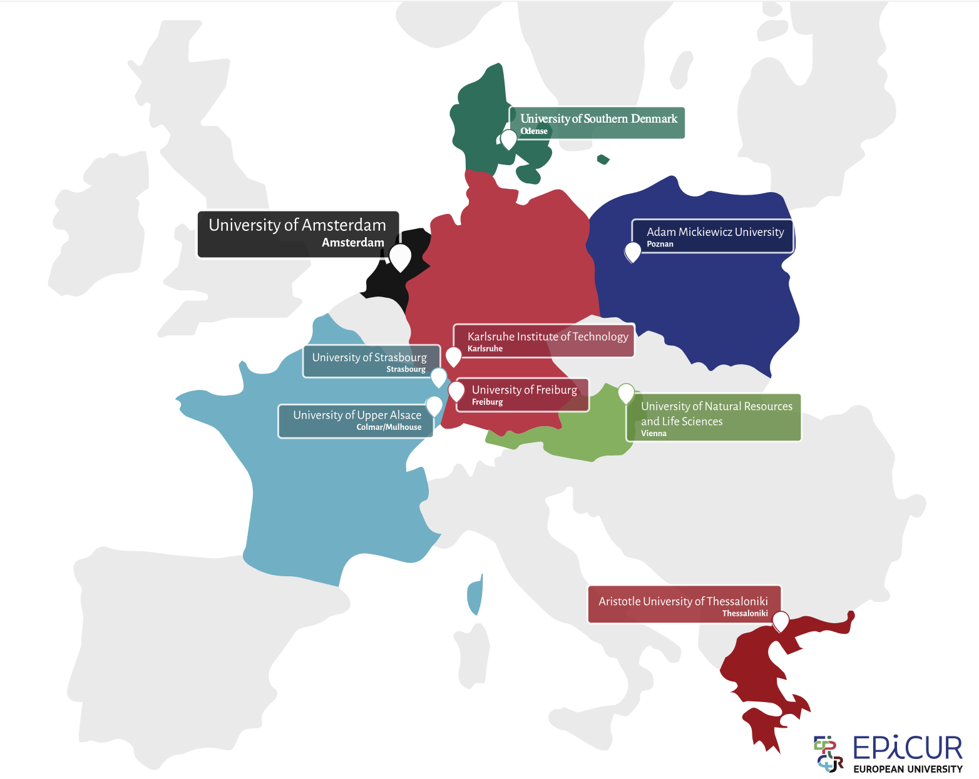










9 Partner Universities Across Europe

Slide 3
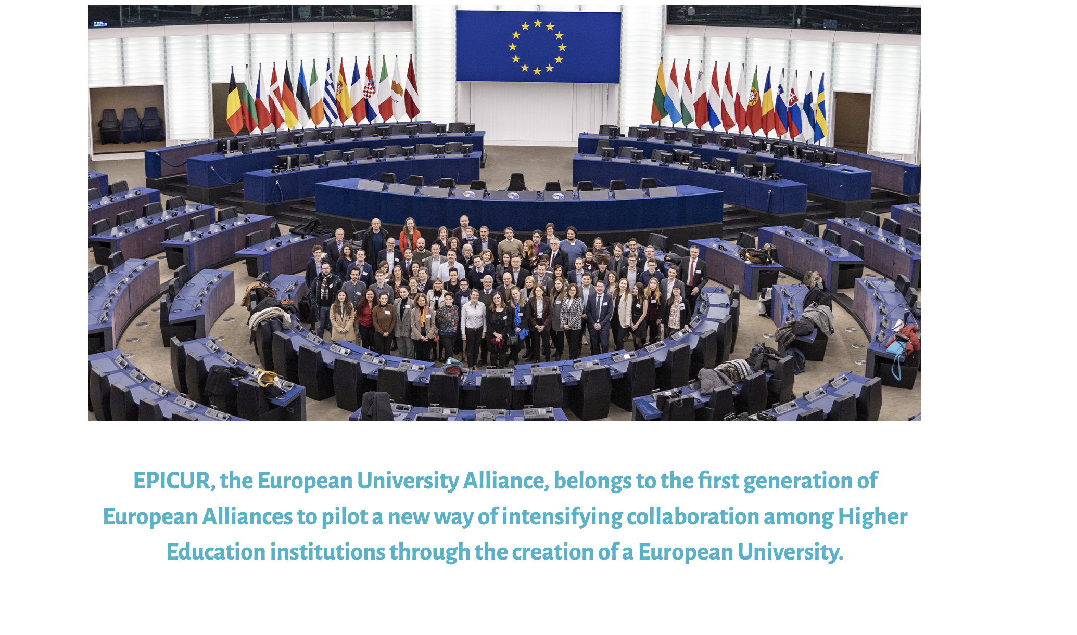

Slide 4

The EPICUR alliance’s core ambition is
transform education & research
transfer practices and opportunities across its member universities
develop original cutting-edge solutions
train new generations of European change makers
able to shape a European society in transition and help overcome the daunting challenges

Slide 5



The EPICUR European University offers you
a free international experience that can easily be combined with your studies.
You can choose virtual, physical, or hybrid education.
Are you interested in gaining a European
learning experience and enriching
your academic journey?

Slide 6


EPICUR supports you throughout your whole university career
promotes your individual learning experience
different types of mobility
courses bearing ECTS credits
cultural openness and diversity
financial support
EPICUR offers mobility opportunities
Distance learning courses over a few days or several weeks
On-site training in the summer and throughout the academic year
Hybrid courses which are taught simultaneously on site and online
Blended courses, where all students physically meet at one University campus
Broaden your horizons and gain the opportunity to explore Europe
easier to access than exchange programs
can be taken every year
can also serve as preparation for a future departure

Slide 7





~So, What EPICUR Offers?
Flexible Mobility
Joint Courses
Digital Campus
Physical, hybrid, or fully virtual options between universities
Interdisciplinary courses earning ECTS credits across the alliance
Virtual inter-university platform for shared teaching and administration
Research & Innovation
MICROCREDENTIALS
Joint research projects and community collaborations
To your Diploma Supplement

Slide 8

“Adolescence 360°” Learning Pathway

Slide 9






“Adolescence 360°” Learning Pathway
Course 1 - Adolescent Health
13 weeks online (2hr/week)
+
1 optional
Workshop Week (Greece)
= 6 ECTS
Course 2- Adolescent Development
Course 3a- Adolescent Learning Psychology
Course 3b- Adolescent Immigrants
Optional-
Adolescent Well-Being Workshop Week

Slide 10
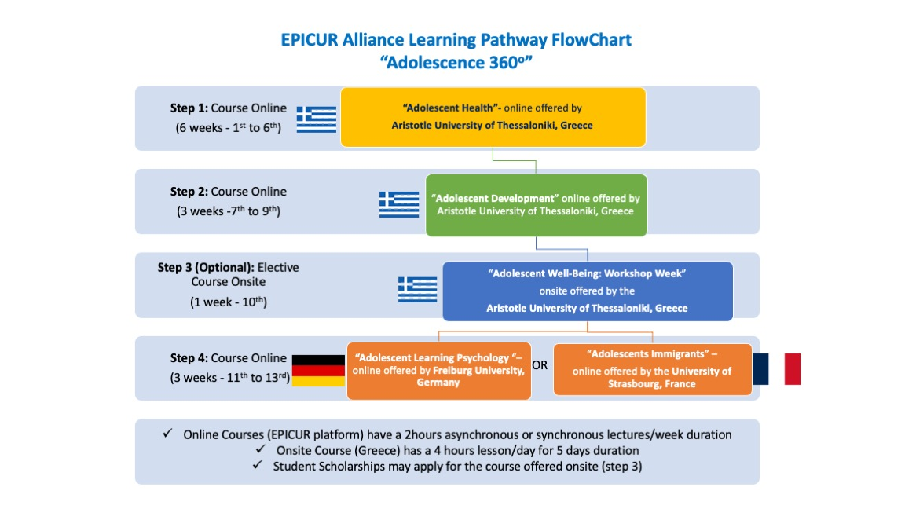


Slide 11
December 1st 2025
Applications Call Deadline

Slide 12
How to Apply by December 1st, 2025
Application Deadline
1
1 December 2025 – Submit through EPICUR Virtual Campus Learning Platform using your AUTH institutional account
2
Course Period
Spring semester 2025–26
13 weeks
Scholarships Available
3
Travel and accommodation funding may be available for on-site Workshop Week. Contact your Home University for details.
Mail from AUSoM secretary with links available

Slide 13


How to Apply by December 1st, 2025
Application Deadline
1
1 December 2025 – Submit through EPICUR Virtual Campus Learning Platform using your AUTH institutional account
2
Course Period
Spring semester 2025–26
Scholarships Available
3
Travel and accommodation funding may be available for on-site Workshop Week. Contact your Home University for details.
Join the Info Session: Saturday, 6 December 2025 at 10:00 EET
Zoom link: https://authgr.zoom.us/j/91409740841?pwd=BKtcTkKOZba5go6CqY7pwACykQ7zCX.1

Slide 14

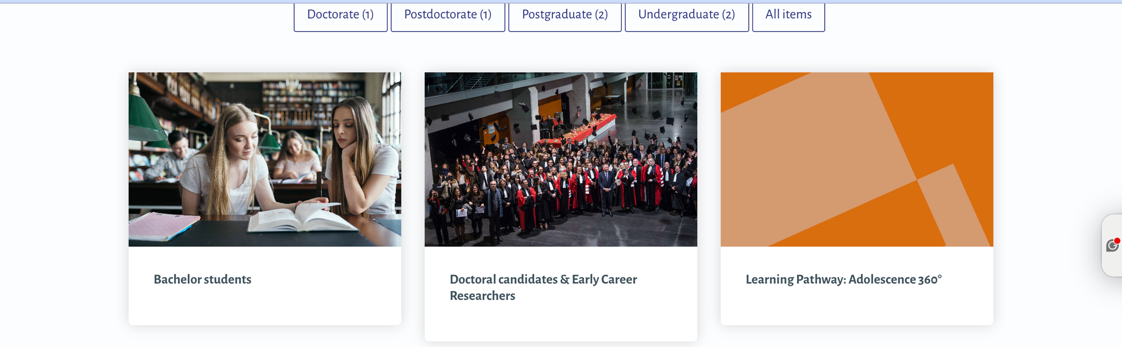
How to Apply by December 1st, 2025
Application Deadline
1
1 December 2025 – Submit through EPICUR Virtual Campus Learning Platform using your AUTH institutional account
2
Course Period
Spring semester 2025–26
Scholarships Available
3
Travel and accommodation funding may be available for on-site Workshop Week. Contact your Home University for details.
Join the Info Session: Saturday, 6 December 2025 at 10:00 EET
Zoom link: https://authgr.zoom.us/j/91409740841?pwd=BKtcTkKOZba5go6CqY7pwACykQ7zCX.1

Slide 15
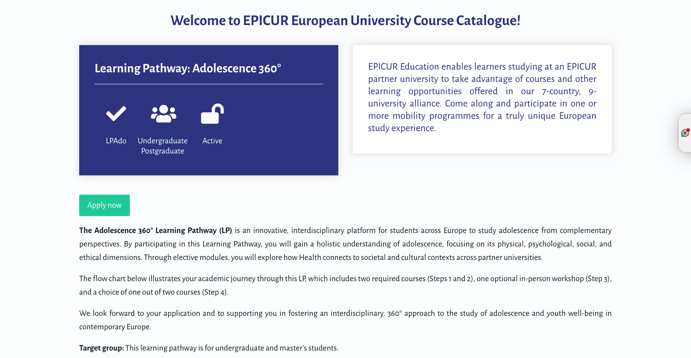
How to Apply by December 1st, 2025
Application Deadline
1
1 December 2025 – Submit through EPICUR Virtual Campus Learning Platform using your AUTH institutional account
2
Course Period
Spring semester 2025–26
Scholarships Available
3
Travel and accommodation funding may be available for on-site Workshop Week. Contact your Home University for details.
Join the Info Session: Saturday, 6 December 2025 at 10:00 EET
Zoom link: https://authgr.zoom.us/j/91409740841?pwd=BKtcTkKOZba5go6CqY7pwACykQ7zCX.1

Slide 16



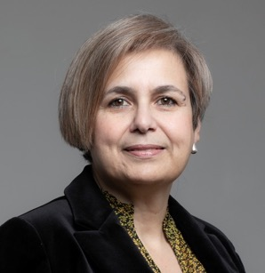



“Adolescence 360°” Learning Pathway

Slide 17

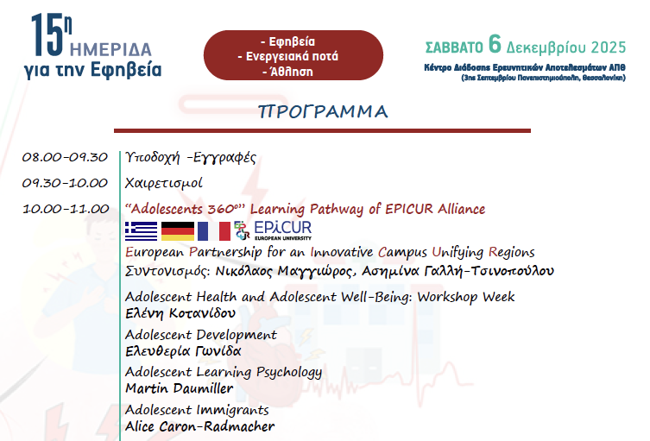

Zoom link: https://authgr.zoom.us/j/91409740841?pwd=BKtcTkKOZba5go6CqY7pwACykQ7zCX.1

Slide 18

epicur-secretariat@auth.gr
December 1st 2025
Applications Call Deadline

